Slide 1
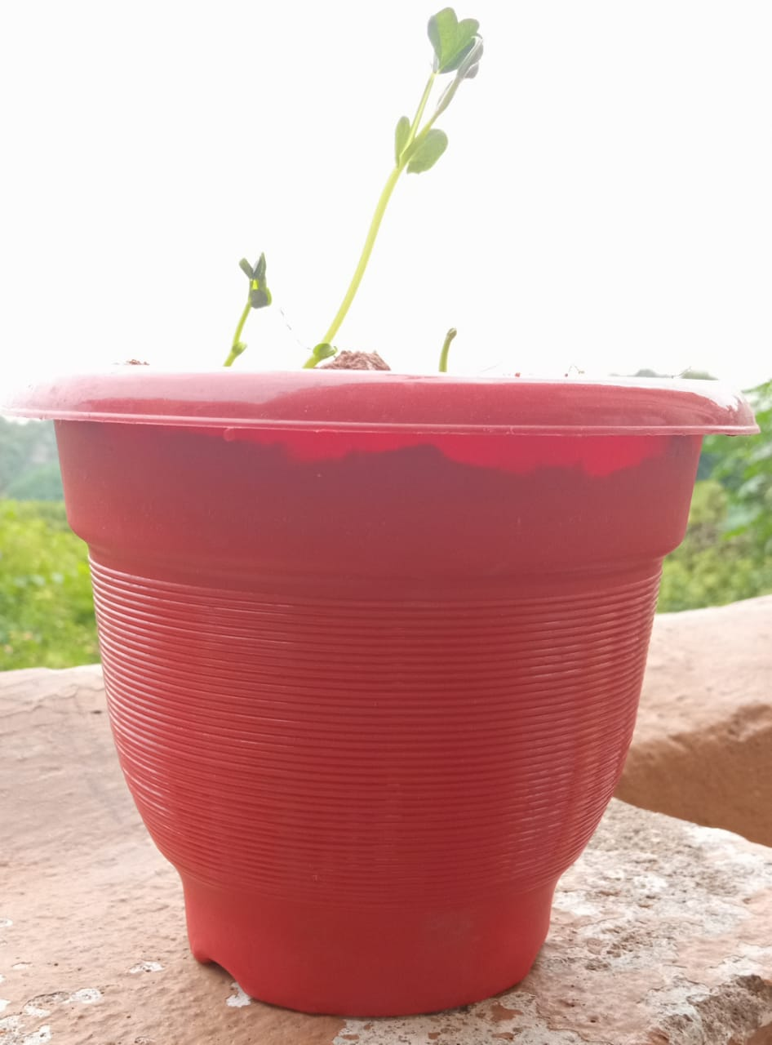

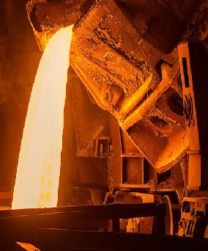


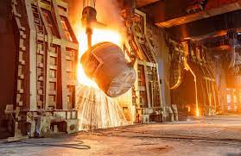




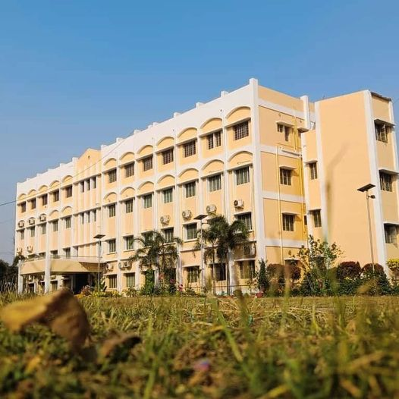
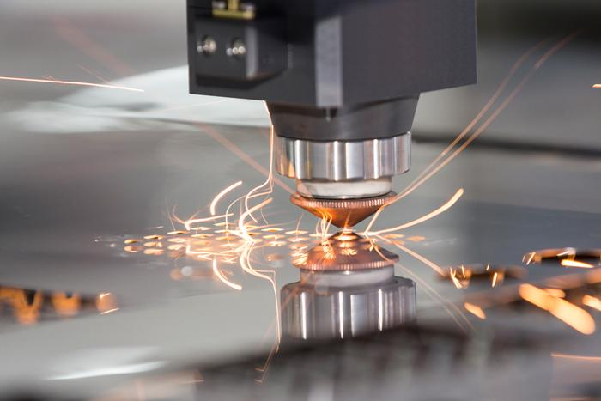
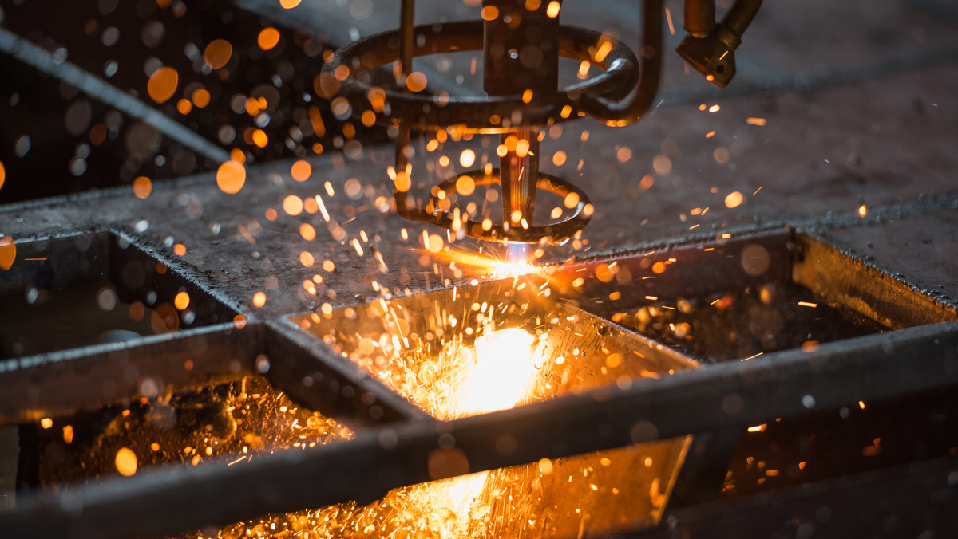
ICPMMM2024
International Conference on Processing
of Minerals, Metals, and Materials :
Beyond Tomorrow
21-23 February, 2024
ORGANIZED BY
Department of Metallurgical Engineering, Kazi Nazrul University, Asansol, INDIA
In Association with
National Institute of Technology, Durgapur, INDIA
National Metallurgical Laboratory, Jamshedpur, INDIA
VENUE : FAIRFIELD BY MARRIOT, KOLKATA, WEST BENGAL, INDIA

Slide 2
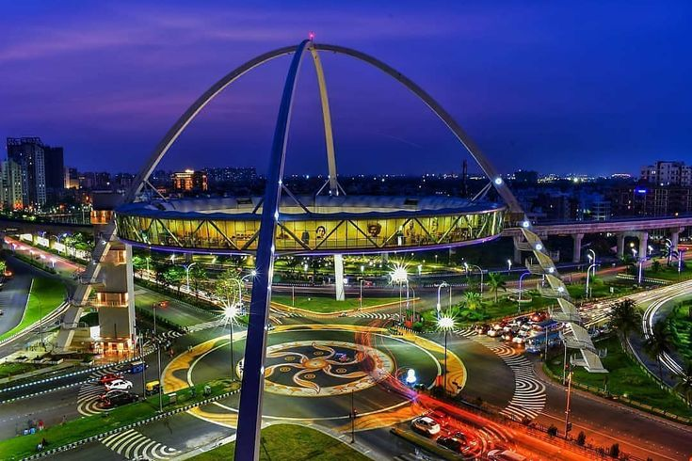
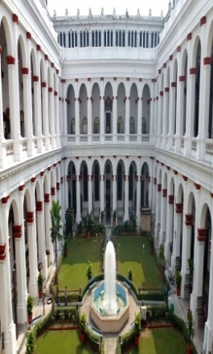
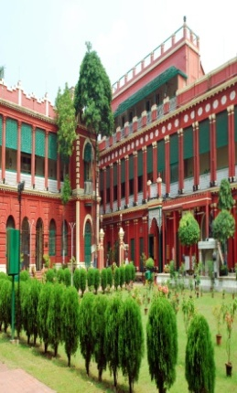
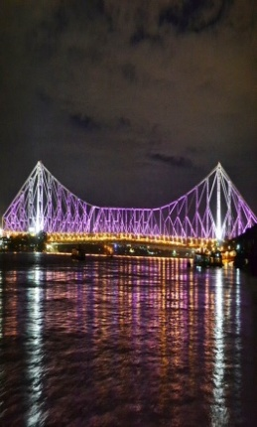
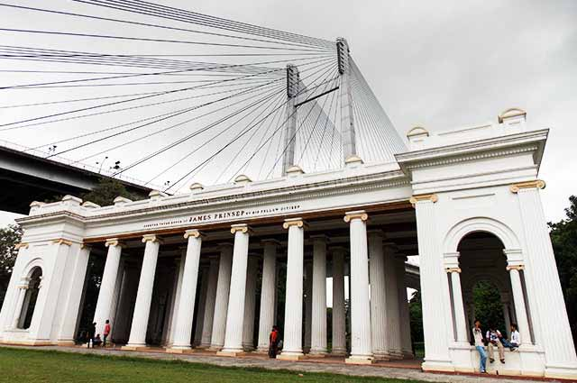
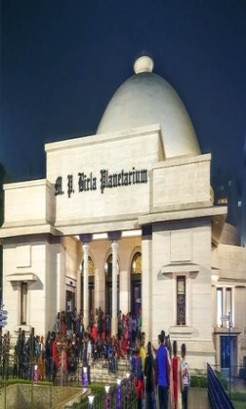
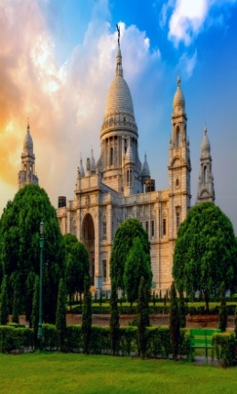
ABOUT THE UNIVERSITY AND THE DEPARTMENT Kazi Nazrul University (KNU), a nascent university in the heart of industrial belt in West Bengal, runs on its campus and also in its affiliated colleges Diploma, UG, PG, M Phil and Ph.D. courses in the Faculty of Arts and fine Arts, Faculty of Science & Technology, Faculty of Law and Faculty of Commerce & Management. It caters to the need of more than forty four thousand students every year. Within eight years of its existence, KNU has put a mark in academia by way of imparting knowledge, developing skills, promoting entrepreneurship among students for making them competent as per needs of the society from the local to the global in various fields including research. Various initiatives have already been taken to internationalize the University for connecting it globally with institutions of repute. As an academic institution KNU believes in four I's - Inspiration, Innovation, Inculcation and Integration. The Department of Metallurgical Engineering in the School of Mines and Metallurgy, KNU, started offering three years diploma in Metallurgical Engineering from 2017. The Department has started offering B. Tech. in Metallurgical and Materials Engineering from 2019 onwards. Both the Diploma and Degree courses are approved by AICTE. The Department has its own Board of Studies (BOS) with experts from eminent institutes, e.g. IITs and NITs. Besides teaching, faculty members are also engaged in collaborative research with various academic and research institutes, and industries. Students undertake vocational training, internship, and research projects in various reputed organizations like IISCO, Tata Hitachi, NML, RINL, and nearby iron and steel plants. KOLKATA CITY Kolkata, India's second biggest city, is a perpetually ongoing festival of human existence, concurrently luxurious, refined, warm, and pointedly futuristic. A vibrant 350-year-old metropolis located on India's Eastern Coast, the capital of West Bengal thrives on contradictions and imposing spectacles; nothing is commonplace in this city. Kolkata, the City of Joy, in every sense, is the artistic, cultural and intellectual capital of the country. Netaji Subhash Chandra Bose International Airport, about 15km from the City Centre, is well connected with other parts of India and abroad as well. Kolkata's streets are vivid, hectic, chaotic, and yet, brimming with life and creativity. Driven by the indomitable spirit of the self-made middle class, the city has created a beautiful juxtaposition of the old colonial-era charm with the nascent upcoming hipster culture that thrives amongst the city's millennial residents. Kolkata has a very lively nightlife and great street food that is famous all across the country. The city is lined with eateries and food stalls at every corner, where you can savour local Bengali food, or try out local snacks like, Jhalmuri, or Ghugni Chaat. Weather in Kolkata during January - February is soothingly enjoyable, with temperature between 16 - 29ºC and mostly bright sunny days.
www.icpmmm2024.com ICPMMM2024
VENUE
Fairfield by Marriott, the vanue, is one of the best hotels in Kolkata, located in the Newtown area, with nice amenities and away from the city chaos. It is 12km from the Metro Station, 12 km from Sealdah Railway Station and 9km from the Airport.

Slide 3
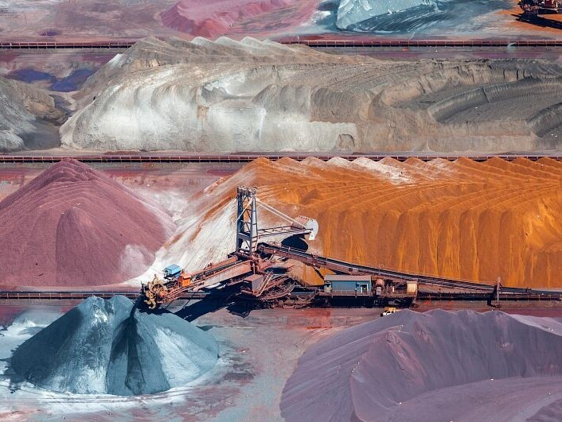
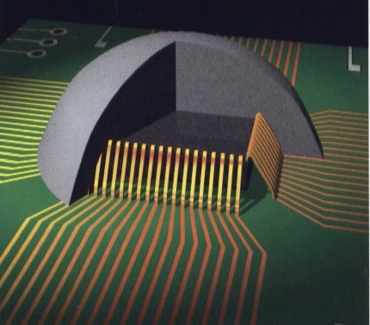
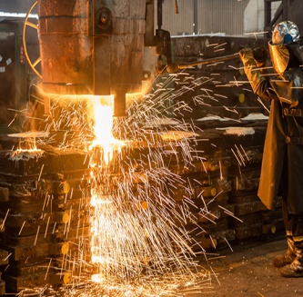
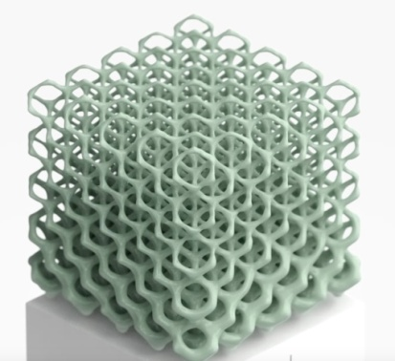

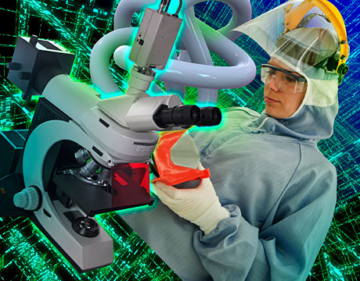
Invitation
www.icpmmm2024.com ICPMMM2024
At the onset, we want to introduce ourselves as a fledgling Department of Metallurgical Engineering of Kazi Nazrul University, a state aided university in the eastern state of West Bengal, India. We are running AICTE approved UG courses as well as doctoral programs duly supported by required infrastructures, well qualified faculty members, close collaborations with industries and research labs, and external fundings. Our faculties are actively engaged in teaching and research and we strive to keep pace with the fast changing world of
Minerals, Metals, and Materials through our research programs. various fields of metallurgical activities across 56 chapters. Membership requirements are stringent to maintain
the highest professional standards. The
scope of the Institute activities include mineral beneficiation, extraction, fabrication, heat treatment, finishing as well as practical and theoretical aspects of metallurgy of all ferrous and non-ferrous metals and alloys. Ceramics and other
disciplines and technologies allied to metallurgical problems also come underthe scope of the Institute.
The activities of the Institute include organizing national and international technical conferences and programmes, research activities, publications, conducting qualifying examinations etc. The Institute has grown into a reputed Institution devoted to promotion and advancement in the study, practice and research of Metallurgical Science and Technology. The KAZI NAZRUL UNIVERSITY is now recognised throughout the world as one of the premier metallurgical organisations.

Slide 4
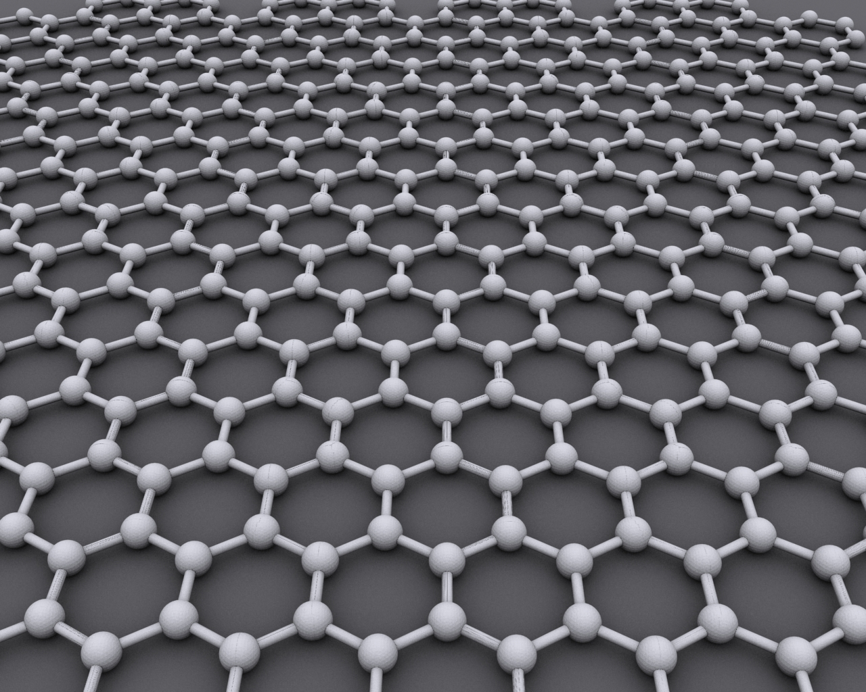
www.icpmmm2024.com ICPMMM2024
Call for Papers
ICPMMMM2024 will cover a wide variety of themes spanning the entire spectrum of activities related to minerals, metals, materials that are of current interest to researchers and professionals from academia, research and industry. The ICPMMM2024 will provide a knowledge-sharing platform on technological advances and will promote collaborations and dialogues among professionals/ researchers so that they can utilize the mutual strengths to deliberate on challenges and opportunities. This IPCMMM2024 will consist of theme based parallel symposia that will be inspiring the professionals and students through career opportunities, technology trends and industry needs. The ICPMMM2024 will be structured around a few broad verticals, which would appropriately leverage invited & keynote lectures from leading experts in the field of metallurgical and materials engineering as well as contributory papers presentations. Overall, The ICPMMM2024 programme is sure to provide the participants an enriching experience. The paper should only submitted by Email at – (icpmmm2024@gmail.com). The conference invites paper on the following themes but not limited to:
Broad Theme
“Processing of Minerals, Metals and Materials : Beyond Tomorrow”
Sub-Themes of Conference
•Ore Beneficiation • Mineralogical Characterization of ores minerals • Design and Development of Mineral Processing Equipments and Process • Simulation of Mineral Processing Circuits • Agglomeration of Ores • Iron Making & Steel Making • Non-Ferrous Extractive Process
• Nano-Materials • Bio-Materials • Composites • Material Science and Engineering Metallography • Bio-materials • Composites, Intermetallics • Materials Property and Characterization • Materials Testing and Control • MEMS Integration • Meta materials • Ceramics and Composites • Electrical, Optical, and Magnetic Materials • Intermetallics and Polymer Manufacturing • Nano materials and its Fabrication • Numerical Modelling and Simulation • Alternate materials / material substitution • Computational Modeling of Metals & Materials • Advanced and Composite Materials • Optical and Electronic Materials • Electronic materials • Microelectronics • Electronic packaging materials
• Metal Forming • Devices • Electronic Packaging Engineer • Surface Engineering Polymers and magnetic materials • Medicinal Implant Materials and Nanometers • Self-healing materials • magnetic and thermoelectric materials • Polycaprolactone are emerging smart structures • 3-D Smart Materials • Carbon Nanotubes, Graphene and Composites • Piezoelectric Materials • Electronic and Semiconductor Materials • Ceramics, Glasses & Composite Materials • Electrical, Optical, and Magnetic Materials • Advanced Nanomaterials • Renewable materials • Functional materials
• Optical fibers and displays • Controlling and Monitoring Devices • Design, Synthesis and Characterization • Smart/Intelligent Materials in Automation and Control • Dielectrics, Nanoscale and Photonic Materials • Intelligent Semiconductor Models • Conventional Superconductor • High-temperature Superconductivity • Detectors, Emitters and Metallization • Thermoelectric and Energy Applications • Additive Manufacturing & 3D Printing • Applications of AI • Corrosions and Degradations

Slide 5
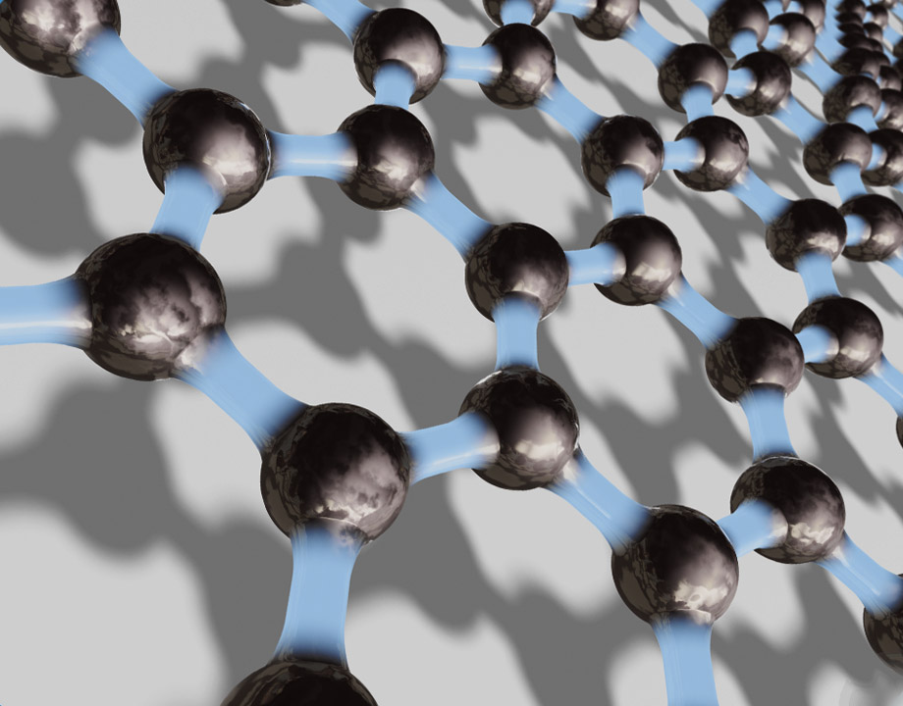
www.icpmmm2024.com ICPMMM2024
Call for Abstracts
Authors are requested to submit abstracts latest by 31st October 2023. The abstract, not exceeding 500 words with maximum five keywords and prepare as per the guide lines, should submitted through Email at (icpmmm2024@gmail.com). The abstract should be prepared using template provided on our website.
Abstract Submission Deadline 31st October, 2023
Guidelines for Authors
• The synthesis of the Paper within 500 words with a maximum of five keywords has to be submitted first and after acceptance of the same, the full text of the Paper has to be submitted.
• Domain experts will review Synopsis and the decision will be communicated to those authors whose synopsis is accepted.
• Full Text Paper should be prepared in line with the follows.
• Papers should be camera-ready in MS-Word format, not exceeding 3000 words in length excluding figures, tables, appendices.
The language of the Publication is English. The mode of presentation should be in third person.
• SI units should be used wherever possible. Other units, if used, should be given only in parentheses preceded by SI units.
• Mathematical symbols should be typed and care should be taken to differentiate between similar characters (e.g. 1 and I), upper and
lower case letters and superscripts and subscripts.
• Lengthy mathematical proofs and derivations and extensive test data are discouraged. If absolutely essential, they should be given as appendices.
Publication Opportunity
The good quality research papers from the conference shall be tried for publication in the Springer journal. The publication of a paper will be subject to the referee’s decision through peer review process and submission of copyright agreement and less than 15% plagiarism report.
Key Dates
Abstract Submission: 31st October, 2023 | Full Paper Submission: 15th December, 2023
Full Paper Acceptance: 15th January, 2024 | Registration Deadline: 31st January, 2024

Slide 6
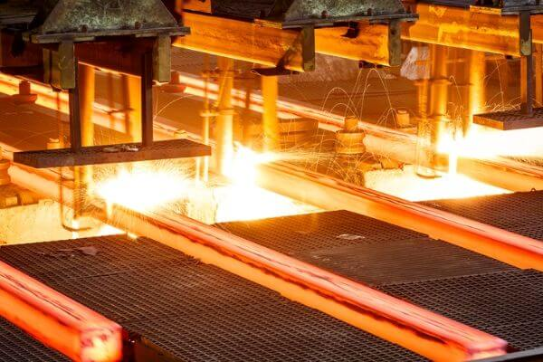


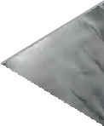







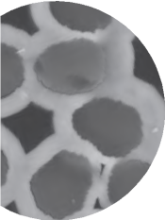
www.icpmmm2024.com ICPMMM2024
Registration
Delegates are requested to register and pay online. Registration fees can be paid by electronic fund transfer or through Demand Draft in favour of “ICPMMM2024” payable at Kolkata
CATEGORY | INR | USD
ACADEMICS | 8000 | 450
INDUSTRY | 9000 | 600
students | 4000 | 300
ACCOMPANY/ SPOUSE | 4000 | 300
Note: Registration is mandatory for participating
Registration and Payment Link :
Prospective participants are requested to visit www.icpmmm2024.in for latest updates.

Slide 7

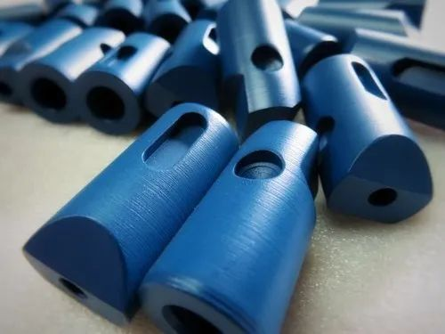
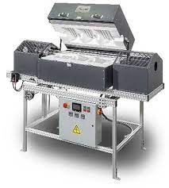
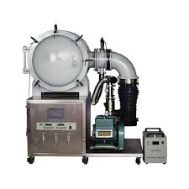
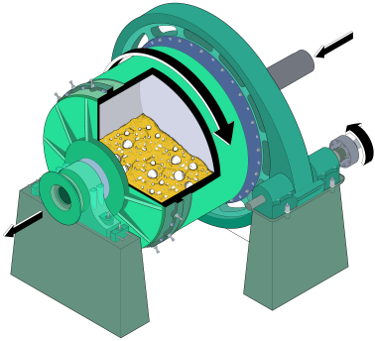
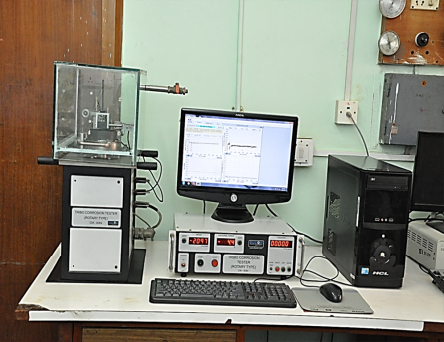
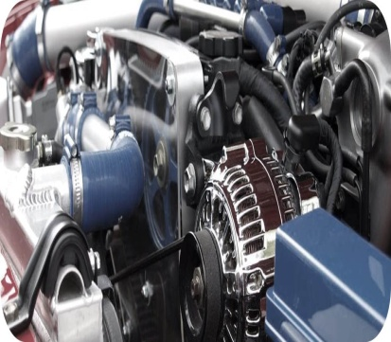
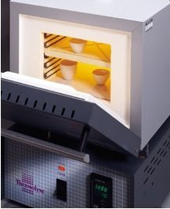

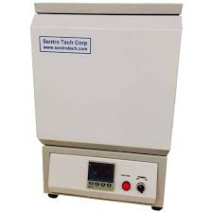
Souvenir
www.icpmmm2024.com ICPMMM2024
Special Attraction
We would like to come forward to help with Dokra Metal Craft which is situated in Bikna village in Bankura. We want that people take more of it in future and not to push their traditional heritage towards extinction. We have seen that most of the people in Bikna village depend on this for their livelihood and both of their sales and profit margins have decreased a lot. So, It should be the moral responsibility of every human being to preserve the heritage.
During ICPMMM2024, a souvenir will be released by the Chief Patron on 20th March, 2024. The Souvenir will contain messages from Govt. functionaries and Eminent professionals, special articles, ATM event details, details about various committees, awards, sponsors/supporters and advertisements from various industries, organizations
from India and abroad.
The soft copy of the souvenir will be provided to all the delegates attending the event. Limited high quality hard copies will be printed for distribution to Govt. agencies, Industries, R&D labs and Academic Institutions.

Slide 8
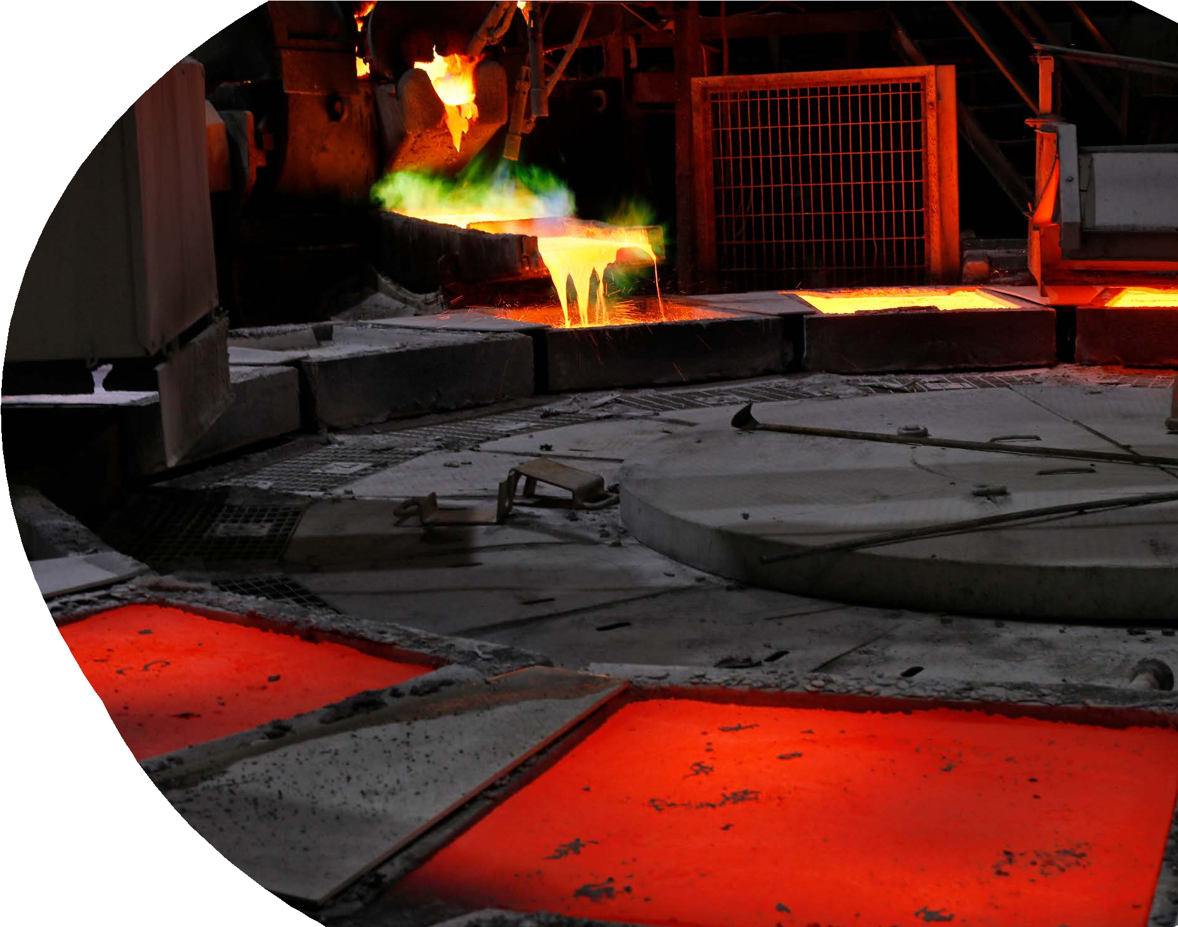

www.icpmmm2024.com ICPMMM2024
ICPMMM2024
Committees for ICPMMM2024
Patrons
Prof. (Dr.) Debashish Bandyopadhyay, Vice Chancellor, KNU
Dr. Chandan Konar, Registrar, KNU
Prof. (Dr. Santanu Kumar Ghosh, Dean Faculty of Science and Technology, KNU
Chairman
Prof. (Dr.) Projjal Basu, KNU
Advisory Committee
INTERNATIONAL | Prof. Sumantra Bhattacharya, Emeritus Fellow, IIT Dhanbad
Prof. Ir. Dr. Cheong Kuan Yew, Universiti Sains Malaysia | Prof. Govind S. Gupta, IISc Bangalore
Ts. Dr. Teo Pao Ter, Universiti Malaysia Kelantan | Dr. Ashis Bhaduri, CEO, TATA Bluescope Steel
Dr Samayamutthirian Palaniandy GM, Eirich Australia/Global Product Manager (TowerMill) | Prof. Somnath Basu, IIT Bombay
Prof Elizabeth Makhatha, HOD, Metallurgy, Univ Johannesburg | Prof. Samit K. Roy, IIT Kharagpur
Mr. Ram Chandra Chakraborty, MD, PSI Metals India Private Limited. | Dr. Sandip Ghosh Choudhury, Chief Scientist, CSIR-NML
Dr Anrin Bhattacharya, CEO, RECYRON, Austria | Mr. S.K Dutta, MD, Duttcon Consultant & Enigineers, Kolkata
 | Dr. Supriyo Bera, HOD, Metallurgical Engineering, NIT Durgapur
NATIONAL | Prof. Karabi Das, HOD, Metallurgical Engineering, IIT Kharagpur
Prof. Rajeev Ahuja, Director, IIT Ropar | Prof. Sutapa Roy Ramanan, BITS Pilani (Goa Campus)
Prof. Pravas Chandra Chakraborti, HOD, Metallurgy, Jadavpur University | Prof. D Ravi Kumar, IIT Delhi
Mr. Arup Krishna Saha, COO, MINEX Metallurgical Company Limited.

Slide 9
www.icpmmm2024.com ICPMMM2024
Technical Committee
ICPMMM2024
Prof. Rajib Dey, Jadavpur University | Dr. Samir Chandra Roy, IIT Ropar
Dr. Soumitra Tarafdar (retd), CSIR NML, Jamshedpur | Dr. Sibnath Kayal, OP Jindal University
Prof. Nikkam Suresh, ISM Dhanbad
Prof. Kaushik Biswas, IIT Kharagpur
Prof. SC Patnaik, IGITS, Sarang, Odisha
Prof. Amitava Basu Mallik, IIEST, Shibpur
Prof. Bankim Roy, NIT Rourkela
Dr. Satadal Ghorai, NIT Durgapur
Organizing Committee
Member | Suman Mondal , Student, KNU
Dr. Arijit Sinha, Associate Professor, KNU | Student Member
Dr. Chanchal Biswas, Assistant Professor, KNU | Agradip Acharya
Dr. Gurudas Mandal, Assistant Professor, KNU | Girish Roy
Mrs. Barnali Sengupta, Assistant Professor, KNU | Subhasish Saha
Hospitality | Ananya Adhikary
Ms. Amrita Bhattacharya, KNU | Anuparna Das
Mr. Somnath Dutta, KNU | Rittik Ghosh
Mr. Sumit Dey, KNU | Snehanjali Mukherjee
Mr. Sagir Khan, KNU | Suresh Naskar
IT Support | Abhishek Nag
Mr. Ashif Ahamed, KNU | Kunal Chandra
Mr. Sourav Jana, KNU | Indrajit Ghanta

Slide 10
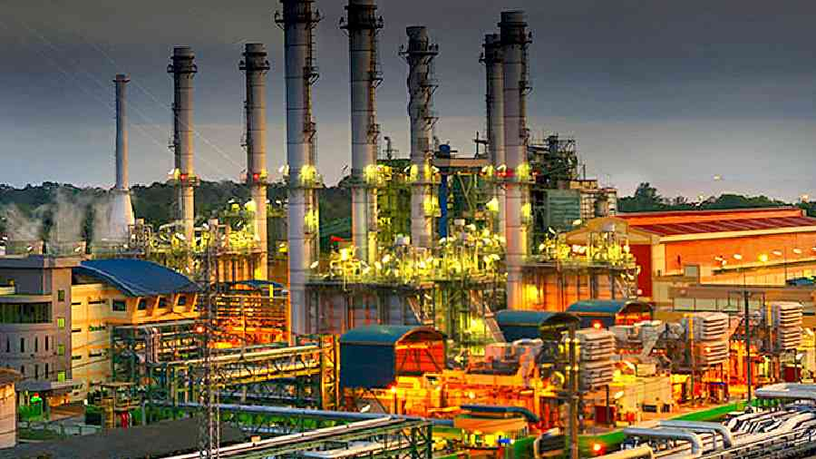

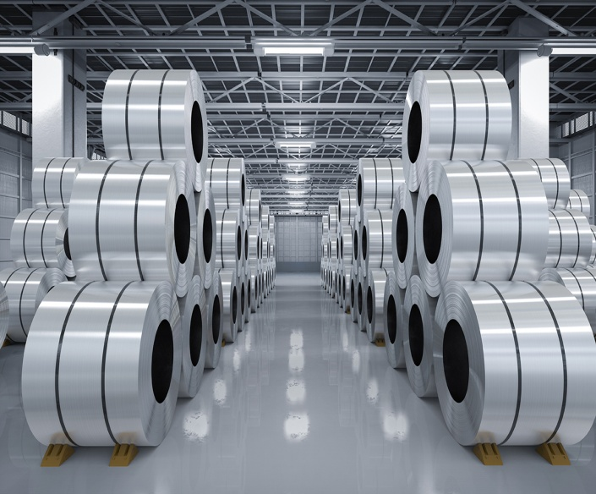

www.icpmmm2024.com ICPMMM2024
Contact
Conference Chairman (Prof. Projjal Basu)
KAZI NAZRUL UNIVERSITY, Asansol-713340, West Bengal, India
Mobile: +91 7406409273
Email: icpmmm2024@gmail.com, metallurgy.projjal@knu.ac.in
For regular updates, please keep eye on
www.icpmmm2024.com

